Slide 1
Akka.net
Pull Request 101

Slide 2
Create a Github Account
http://github.com

Slide 3
Install GitHub
http://github.com
https://help.github.com/articles/set-up-git/

Slide 4
Configure GitHub
http://github.com
https://help.github.com/articles/set-up-git/
https://help.github.com/articles/caching-your-github-password-in-git/

Slide 5
Fork Akka.net
https://github.com/akkadotnet/akka.net

Slide 6
Review the Contribution Details
https://github.com/akkadotnet/akka.net
https://github.com/akkadotnet/akka.net/blob/dev/CONTRIBUTING.md

Slide 7
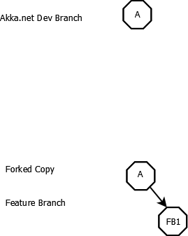
Day One Forked Copy & Created Feature Branch with one commit

Slide 8
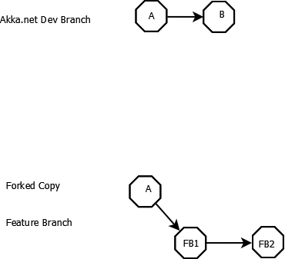
Day Two added second commit

Slide 9
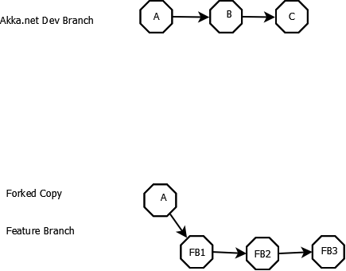
Day Three third commit

Slide 10
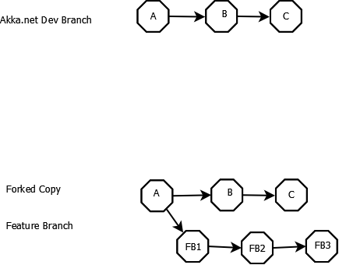
Day Four Get Upstream commits

Slide 11
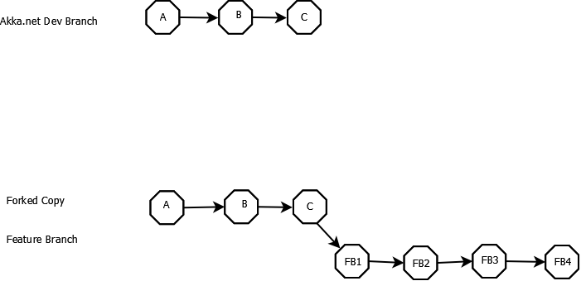
Rebase and add last commit

Slide 12
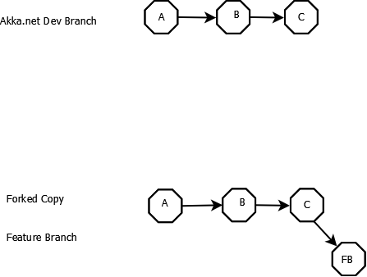
Squash Feature Branch

Slide 13
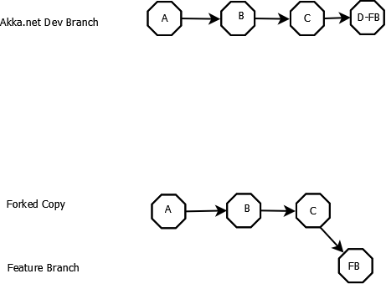
Feature PR Accepted

Slide 14
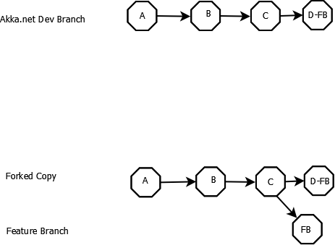
Get Upstream after accept PR

